Slide 1
Bucket sort worksheets

Slide 2
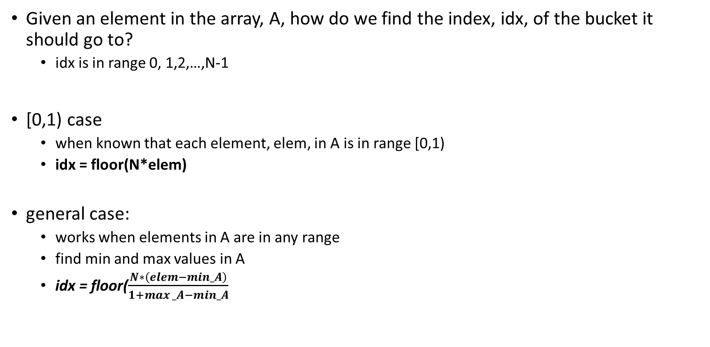
Index calculation
Given an element in the array, A, how do we find the index, idx, of the bucket it should go to?
  idx is in range 0, 1,2,…,N-1
[0,1) case
  when known that each element, elem, in A is in range [0,1)
  idx = floor(N*elem)
general case:
  works when elements in A are in any range
  find min and max values in A
  idx = floor($\frac{N∗\left(elem−min_A\right)}{1+max⁡_A−min_A}$
Goal:
N = _______
number of buckets = ________
indexes for buckets: ___________
Map: elem -> index
min -> __________
max -> __________

Slide 3
Index calculation - special case [0,1)
N = _______
number of buckets = ________
indexes for buckets: ___________
given: each element, elem, in A is in range [0,1)
idx = floor(N*elem)
Exercise 1:
It is given that A has elements in range [0,1).
A = {0.9, 0.71, 0.23, 0.05}
Use formula:__________ N = ____
elem: ____ index____ calc ___________________
elem: ____ index____ calc ___________________
elem: ____ index____ calc ___________________
elem: ____ index____ calc ___________________
elem: ____ index____ calc ___________________

Slide 4
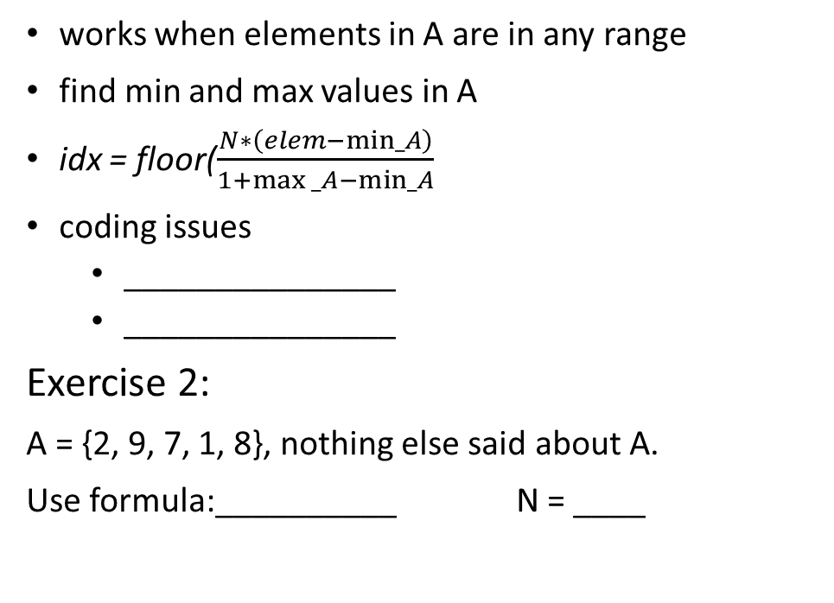
Index calculation - general case
N = _______
number of buckets = ________
indexes for buckets: ___________
Map:
min -> __________
max -> __________
works when elements in A are in any range
find min and max values in A
idx = floor($\frac{N∗\left(elem−min_A\right)}{1+max⁡_A−min_A}$
coding issues
  _______________
  _______________
Exercise 2:
A = {2, 9, 7, 1, 8}, nothing else said about A.
Use formula:__________ N = ____
elem: ____ index____ calc ___________________
elem: ____ index____ calc ___________________
elem: ____ index____ calc ___________________
elem: ____ index____ calc ___________________
elem: ____ index____ calc ___________________

Slide 5
Bucket Sort - Practice
Exercise 3:
Give both an example of the data and the time complexity for:
Best case: A=[___, ___, ___, ___ ] O( ) Explanation:
Worst case: A=[___, ___, ___, ___, ___] O( ) Explanation:
Notes:
Best case: A=[0.3,0.8, 0.1,0.7,] O( N ) Explanation: one number per bucket
Worst case: A=[0.2, 0.22, 0.20, 0.2, 0.26] O( N² ) Explanation: all numbers in the same bucket

